Slide 1


CS 456/656 Computer Networks
Lecture 4: Application Layer – Part 2
Mina Tahmasbi Arashloo and Uzma Maroof
Fall 2025

Slide 2

A note on slides
Adapted from the slides that accompany this book.
All material copyright 1996-2023
J.F Kurose and K.W. Ross, All Rights Reserved
Computer Networking: A Top-Down Approach 8th edition Jim Kurose, Keith Ross Pearson, 2020

Slide 3
Examples applications we will discuss
Web applications: client-server
Fetching data for network applications from servers
Using a reliable connection-based transport-layer service
Video streaming: client-server
P2P file distribution: peer-to-peer
E-Mail: client-server
How?

Slide 4

Communicating with the transport layer
application
transport
network
link
physical
M
application
transport
network
link
physical
Application exchanges messages to implement some application service
using services of transport layer
source
destination

Slide 5
Communicating with the transport layer
application
transport
network
link
physical
M
application
transport
network
link
physical
Application exchanges messages to implement some application service
using services of transport layer
How do applications communicate with the transport layer?
source
destination

Slide 6
Communicating with the transport layer
The application should specify
The destination that will receive the data
What type of transport service it wants
Connection-based or connection-less?
Reliable or unreliable?
…
The data that should be sent
??

Slide 7
Communication endpoints are processes
process: program running within a host
within same host, two processes communicate using inter-process communication (defined by operating system)
processes in different hosts communicate by exchanging messages over the network.
clients, servers
client process: process that initiates communication
server process: process that waits to be contacted
note: applications with P2P architectures have client processes & server processes

Slide 8
Addressing processes
to receive messages, process must have identifier
host device has unique 32-bit IP address
Q: How do we find the IP address?

Slide 9
Addressing processes
to receive messages, process must have identifier
host device has unique 32-bit IP address
Q: does IP address of host on which process runs suffice for identifying the process?
identifier includes both IP address and port numbers associated with process on host.
example port numbers:
HTTP server: 80
mail server: 25
to send HTTP message to gaia.cs.umass.edu web server:
IP address: 128.119.245.12
port number: 80
A: no, many processes can be running on same host

Slide 10
Communicating with the transport layer
The application should specify
The destination that will receive the data
What type of transport service it wants
Connection-based or connection-less?
Reliable or unreliable?
…
The data that should be sent
Using Internet protocols
IP address and port
TCP for reliable connection-based service
UDP for unreliable connection-less service
For applications using the Internet protocols, the common interface to the transport layer is the socket interface.

Slide 11
Sockets
process sends/receives messages to/from its socket
socket analogous to door
sending process shoves message out door
sending process relies on transport infrastructure on other side of door to deliver message to socket at receiving process
two sockets involved: one on each side
application
socket
application
controlled by
app developer
process
process
transport
transport
network
network
controlled
by OS
link
Internet
link
physical
physical

Slide 12
Socket programming
goal: learn how to build client/server applications that communicate using sockets
socket: door between application process and end-to- end transport protocol
application
socket
application
controlled by
app developer
process
process
transport
transport
network
network
controlled
by OS
link
Internet
link
physical
physical

Slide 13
Socket programming
Two socket types for two transport services:
UDP: unreliable datagram
TCP: reliable, byte stream-oriented
Application Example:
client reads a line of characters (data) from its keyboard and sends data to server
server receives the data and converts characters to uppercase
server sends modified data to client
client receives modified data and displays line on its screen

Slide 14
Socket programming with UDP
UDP: no “connection” between client and server:
no handshaking before sending data
sender attaches IP destination address and port # to each packet
receiver extracts sender IP address and port# from received packet
UDP: transmitted data may be lost or received out-of-order
Application viewpoint:
UDP provides unreliable transfer of groups of bytes (“datagrams”) between client and server processes

Slide 15
Client/server socket interaction: UDP
server (running on serverIP)
client
create socket:
create socket, port= x:
clientSocket =
socket(AF_INET,SOCK_DGRAM)
serverSocket =
socket(AF_INET,SOCK_DGRAM)
Create datagram with serverIP address
And port=x; send datagram via clientSocket
read datagram from
serverSocket
application
application
write reply to
serverSocket
specifying client address,
port number
process
process
read datagram from
clientSocket
transport
transport
network
network
link
Internet
link
close
clientSocket
physical
physical

Slide 16
Example app: UDP client
Python UDPClient
include Python’s socket library
from socket import *
serverName = 'hostname'
serverPort = 12000
clientSocket = socket(AF_INET,
SOCK_DGRAM)
message = input('Input lowercase sentence:')
clientSocket.sendto(message.encode(),
(serverName, serverPort))
modifiedMessage, serverAddress =
clientSocket.recvfrom(2048)
print(modifiedMessage.decode())
clientSocket.close()
create UDP socket
get user keyboard input
attach server name, port to message; send into socket
read reply data (bytes) from socket
print out received string and close socket
Note: this code update (2023) to Python 3
Notes:
UDO and TCP code updates 3/23

Slide 17
Example app: UDP server
Python UDPServer
from socket import *
serverPort = 12000
serverSocket = socket(AF_INET, SOCK_DGRAM)
serverSocket.bind(('', serverPort))
print('The server is ready to receive')
while True:
message, clientAddress = serverSocket.recvfrom(2048)
modifiedMessage = message.decode().upper()
serverSocket.sendto(modifiedMessage.encode(),
clientAddress)
create UDP socket
bind socket to local port number 12000
loop forever
Read from UDP socket into message, getting client’s address (client IP and port)
send upper case string back to this client
Note: this code update (2023) to Python 3

Slide 18
Socket programming with TCP
Client must contact server
To establish a connection
server must have created a socket (door) that welcomes client’s contact
Client creates TCP socket, specifying IP address, port number of server process
when client creates socket: client TCP establishes connection to server TCP
when contacted by client, server TCP creates new socket for server process to communicate with that particular client
allows server to establish connections with multiple clients
client source port # and IP address used to distinguish clients (more in Chap 3)
Application viewpoint
TCP provides reliable, in-order
byte-stream transfer (“pipe”)
between client and server processes

Slide 19
Client/server socket interaction: TCP
server (running on hostid)
client
create socket,
port=x, for incoming request:
serverSocket = socket()
wait for incoming
connection request
TCP
connection setup
create socket,
connect to hostid, port=x
connectionSocket =
serverSocket.accept()
clientSocket = socket()
send request using
clientSocket
read request from
connectionSocket
write reply to
connectionSocket
read reply from
clientSocket
close
connectionSocket
close
clientSocket

Slide 20
Example app: TCP client
Python TCPClient
from socket import *
serverName = 'servername'
serverPort = 12000
clientSocket = socket(AF_INET, SOCK_STREAM)
clientSocket.connect((serverName,serverPort))
sentence = input('Input lowercase sentence:')
clientSocket.send(sentence.encode())
modifiedSentence = clientSocket.recv(1024)
print ('From Server:', modifiedSentence.decode())
clientSocket.close()
create TCP socket for server, remote port 12000
No need to attach server name, port
Note: this code update (2023) to Python 3

Slide 21
Example app: TCP server
Python TCPServer
from socket import *
serverPort = 12000
serverSocket = socket(AF_INET,SOCK_STREAM)
serverSocket.bind(('',serverPort))
serverSocket.listen(1)
print('The server is ready to receive')
while True:
connectionSocket, addr = serverSocket.accept()
sentence = connectionSocket.recv(1024).decode()
capitalizedSentence = sentence.upper()
connectionSocket.send(capitalizedSentence.
encode())
connectionSocket.close()
create TCP welcoming socket
server begins listening for incoming TCP requests
loop forever
server waits on accept() for incoming requests, new socket created on return
read bytes from socket (but not address as in UDP)
close connection to this client (but not welcoming socket)
Note: this code update (2023) to Python 3

Slide 22
Communicating with the transport layer
Is the socket interface the only interface?
It is the most common, but there are others
Applications have evolved quite a lot since the Socket API was created
They want options more than just reliable vs unreliable service
E.g., performance, security, semi-reliability, etc.
Research question: What is a good interface for the application to tell the transport layer about their needs?
We’ll talk more about this when we discuss the transport layer

Slide 23
Examples applications we will discuss
Web applications: client-server
Video streaming: client-server
P2P file distribution: peer-to-peer

Slide 24

Example: Video Streaming
spatial coding example: instead of sending N values of same color (all purple), send only two values: color value (purple) and number of repeated values (N)
video: sequence of images displayed at constant rate
e.g., 24 images/sec
digital image: array of pixels
each pixel represented by bits
coding: use redundancy within and between images to decrease # bits used to encode image
spatial (within image)
temporal (from one image to next)
……………………..
……………….…….
frame i
temporal coding example: instead of sending complete frame at i+1, send only differences from frame i
frame i+1

Slide 25
Example: Video Streaming
spatial coding example: instead of sending N values of same color (all purple), send only two values: color value (purple) and number of repeated values (N)
CBR: (constant bit rate): video encoding rate fixed
VBR: (variable bit rate): video encoding rate changes as amount of spatial, temporal coding changes
examples:
MPEG 1 (CD-ROM) 1.5 Mbps
MPEG2 (DVD) 3-6 Mbps
MPEG4 (often used in Internet, 64Kbps – 12 Mbps)
……………………..
……………….…….
frame i
temporal coding example: instead of sending complete frame at i+1, send only differences from frame i
frame i+1

Slide 26


Streaming stored video
simple scenario:
Internet
video server
(stored video)
client
Main challenges:
server-to-client bandwidth will vary over time, why?
with changing network congestion levels (in house, access network, network core, video server)
packet loss, delay due to congestion will delay playout, or result in poor video quality

Slide 27
Streaming stored video
Cumulative data
2. video
sent
video
recorded (e.g., 30 frames/sec)
3. video received, played out at client
(30 frames/sec)
network delay
(fixed in this example)
time
streaming: at this time, client playing out early part of video, while server still sending later part of video

Slide 28
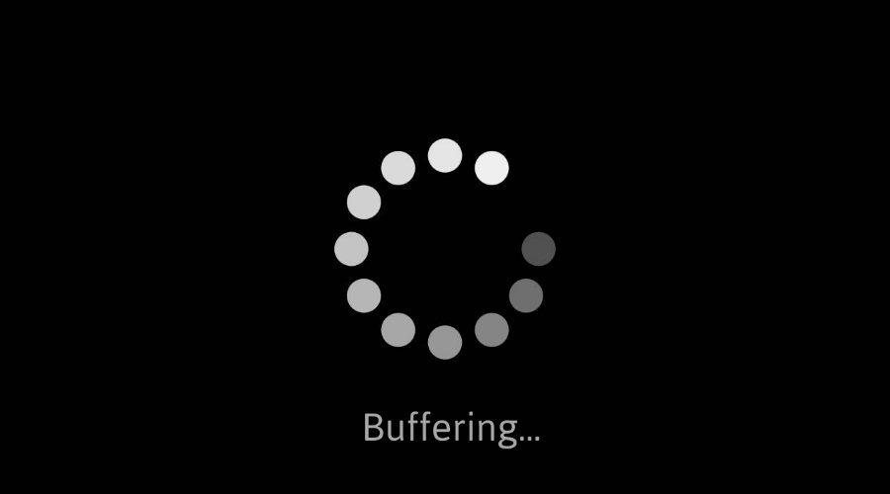
Streaming stored video: challenges
continuous playout constraint: during client video playout, playout timing must match original timing
… but network delays are variable (jitter), so will need client-side buffer to match continuous playout constraint
other challenges:
client interactivity: pause, fast-forward, rewind, jump through video
video packets may be lost, retransmitted
Notes:
deal with a constraint : continuous playout constraint and this means that the timing of playout at the client side is going to have to match the timing from when the video was first recorded. so you're sitting at the client you're playing out the video everyone's engaged it's time to play out a piece of video that piece of video better have arrived from the server to the client in order to be played out if not we're going to see that spinning dial that you see here that we've all seen at one time or another
the source of the challenge here is the variable delay between the video server and the client and to mitigate that delay we're going to use buffering to absorb some of those changes in delay there are other challenges as well like
how to deal with client side operations like fast forward and rewind and if packets are lost they'll be retransmitted if we're streaming over tcp resulting in additional delay so a fundamental challenge we'll need to address is that of variable network delays

Slide 29
Streaming stored video: playout buffering
constant bit
rate video
transmission
client video
reception
constant bit
rate video
playout at client
Cumulative data
variable
network
delay
buffered
video
client playout
delay
time
client-side buffering and playout delay: compensate for network-added delay, delay jitter

Slide 30




Video streaming in practice
stream video traffic: major consumer of Internet bandwidth
Netflix, YouTube, Amazon Prime: 80% of residential ISP traffic (2020)
challenge: scale - how to efficiently get content to millions of users?
challenge: heterogeneity
different users have different capabilities (e.g., wired versus mobile; high vs low bandwidth)

Slide 31
Idea 1: Content distribution networks (CDNs)
challenge: how to stream content (selected from millions of videos) to hundreds of thousands of simultaneous users?
option 1: single, large “mega-server”
single point of failure
point of network congestion
long (and possibly congested) path to distant clients
….quite simply: this solution doesn’t scale

Slide 32


Idea 1: Content distribution networks (CDNs)
challenge: how to stream content (selected from millions of videos) to hundreds of thousands of simultaneous users?
option 2: store/serve multiple copies of videos at multiple geographically distributed sites (CDN)
enter deep: push CDN servers deep into many access networks
close to users
Akamai: 240,000 servers deployed
in > 120 countries (2015)
bring home: smaller number (10’s) of larger clusters in Internet exchange points (IXPs)
used by Limelight
Notes:
Bring home: a smaller number of larger server Clusters are located in pops points of presence
Limelight: Fewer (hundreds of locations globally) vs alkamai: Thousands of PoPs (possibly the most of any CDN)
Limelight: Focused on large PoPs in fewer, high-traffic locations vs alkamai: Uses a massive, highly distributed edge network

Slide 33
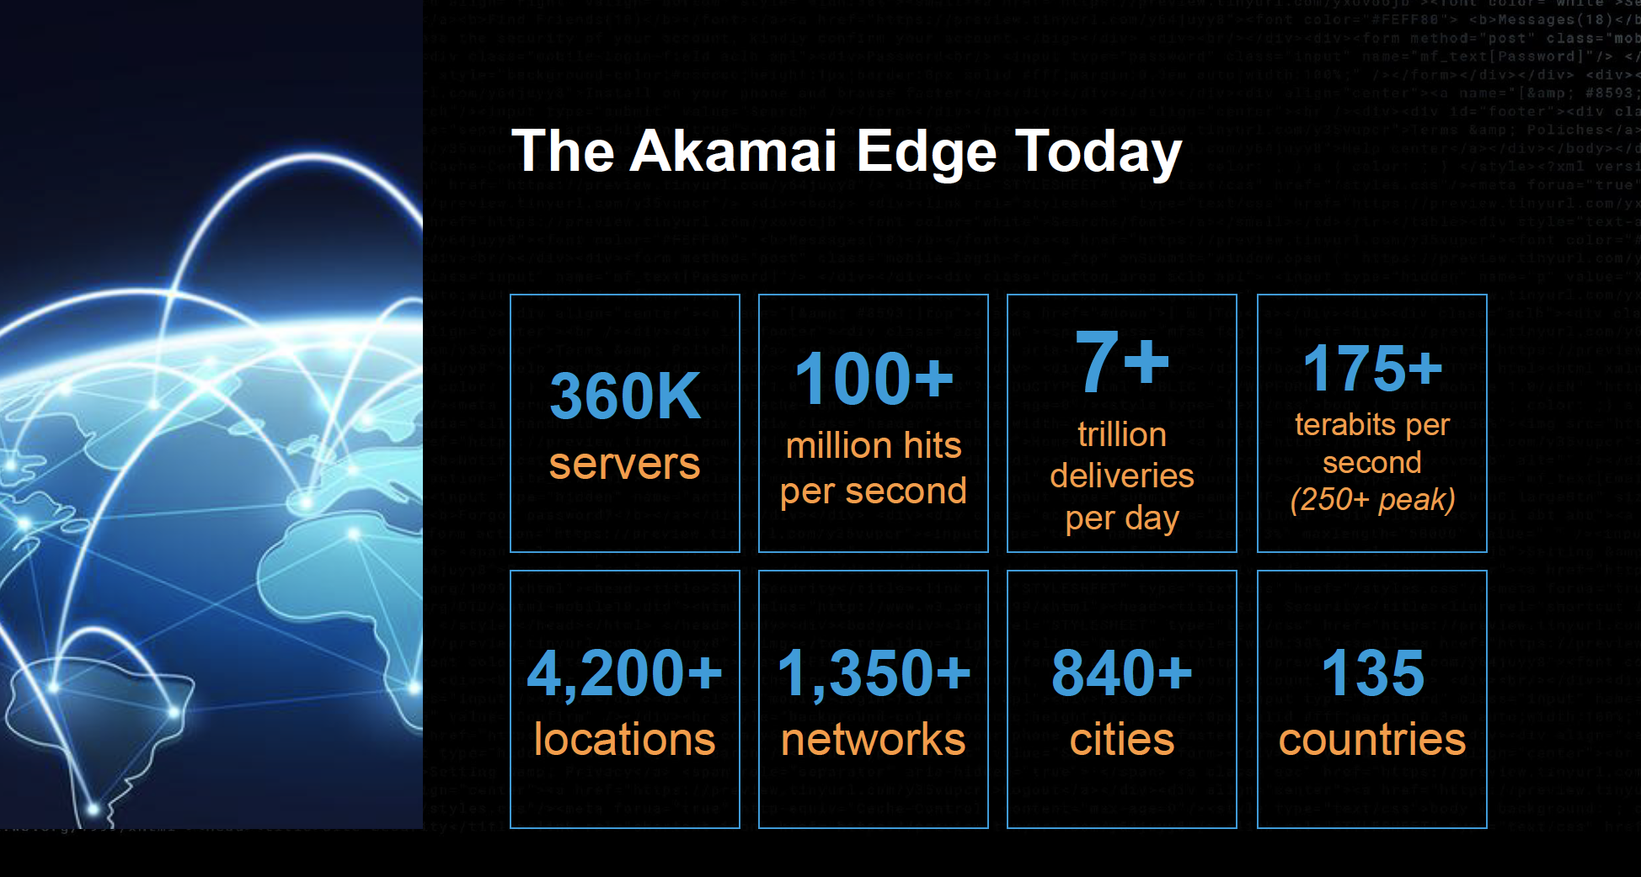
Example CDN: Akamai
Source: https://networkingchannel.eu/living-on-the-edge-for-a-quarter-century-an-akamai-retrospective-downloads/

Slide 34
Idea 1: Content distribution networks (CDNs)
challenge: how to stream content (selected from millions of videos) to hundreds of thousands of simultaneous users?
option 2: store/serve multiple copies of videos at multiple geographically distributed sites (CDN)
enter deep: push CDN servers deep into many access networks
close to users
Akamai: 240,000 servers deployed
in > 120 countries (2015)
bring home: smaller number (10’s) of larger clusters in Internet exchange points (IXPs)
used by Limelight
Notes:
Bring home: a smaller number of larger server Clusters are located in pops points of presence
Limelight: Fewer (hundreds of locations globally) vs alkamai: Thousands of PoPs (possibly the most of any CDN)
Limelight: Focused on large PoPs in fewer, high-traffic locations vs alkamai: Uses a massive, highly distributed edge network

Slide 35

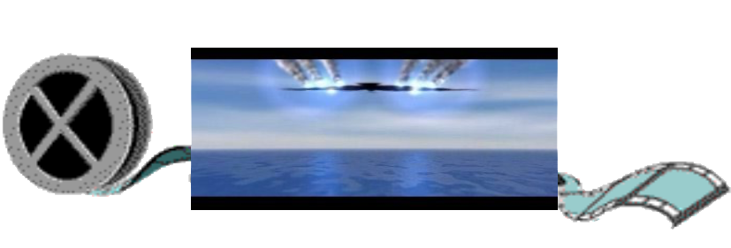
Idea 2: DASH (Dynamic Adaptive Streaming over HTTP)
“intelligence” at client: client determines
when to request chunk (so that buffer starvation, or overflow does not occur)
what encoding rate to request (higher quality when more bandwidth available)
...
...
?
...
client
where to request chunk (can request from URL server that is “close” to client or has high available bandwidth)
Streaming video = encoding + DASH + playout buffering

Slide 36



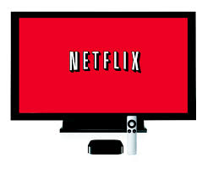
Video streaming example: Netflix
Netflix: stores copies of content (e.g., MADMEN) at its (worldwide) OpenConnect CDN nodes
subscriber requests content, service provider returns manifest
using manifest, client retrieves content at highest supportable rate
may choose different rate or copy if network path congested
…
…
…
manifest file
…
where’s Madmen?
…
…
Notes:
36
Akamai: 100,000+ servers in 1000+ clusters in 1000+ networks in 70+ countries serving trillions of requests a day.
How many people use Netflix?

Slide 37
Video streaming example: Netflix
Some interesting design decisions services like Netflix need to make:
What content to place in which CDN nodes?
From which CDN node to retrieve content? At which rate?
…
…
…
…
…
…
Notes:
37
Akamai: 100,000+ servers in 1000+ clusters in 1000+ networks in 70+ countries serving trillions of requests a day.
How many people use Netflix?

Slide 38

Video streaming example: Netflix
Amazon cloud
upload copies of multiple versions of video to CDN servers
CDN
server
Netflix registration,
accounting servers
3. Manifest file
returned for
requested video
2. Bob browses
Netflix video
CDN
server
2
3
1
1. Bob manages Netflix account
CDN
server
4. DASH streaming

Slide 39
Examples applications we will discuss
Web applications: client-server
Video streaming: client-server
P2P file distribution: peer-to-peer

Slide 40

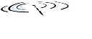




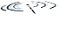






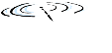


Reminder: Peer-to-peer (P2P) architecture
no always-on server
arbitrary end systems directly communicate
peers request service from other peers, provide service in return to other peers
self scalability – new peers bring new service capacity, and new service demands
peers are intermittently connected and change network addresses
complex management
examples: P2P file sharing (BitTorrent)
mobile network
national or global ISP
local or regional ISP
home network
content
provider
network
datacenter
network
enterprise
network

Slide 41
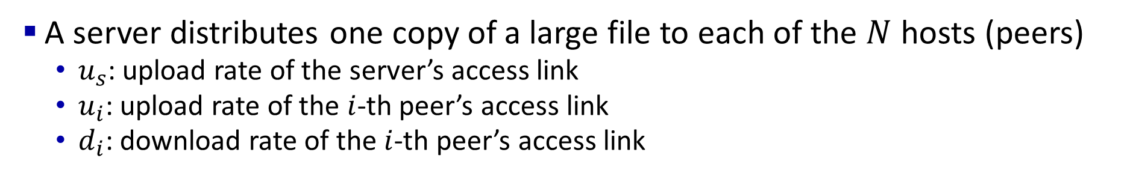
File distribution
A server distributes one copy of a large file to each of the $N$ hosts (peers)
$u_{s}$: upload rate of the server’s access link
$u_{i}$: upload rate of the $i$-th peer’s access link
$d_{i}$: download rate of the $i$-th peer’s access link
u_{s}: server upload capacity
d_{i}: peer i download capacity
file, size F
u₁
d₁
u₂
u_{s}
d₂
server
d_{i}
u_{N}
network (with abundant
bandwidth)
u_{i}
d_{N}
u_{i}: peer i upload capacity

Slide 42
File distribution: client-server vs P2P
Q: how much time to distribute file (size F) from one server to N peers?
peer upload/download capacity is limited resource
u_{s}: server upload capacity
d_{i}: peer i download capacity
file, size F
u₁
d₁
u₂
u_{s}
d₂
server
d_{i}
u_{N}
network (with abundant
bandwidth)
u_{i}
d_{N}
u_{i}: peer i upload capacity

Slide 43
File distribution time: client-server
server transmission: must sequentially send (upload) N file copies:
No one else “helps” in uploading
time to send one copy: F/u_{s}
time to send N copies: NF/u_{s}
F
u_{s}
d_{i}
network
client: each client must download file copy
d_{min} = min client download rate
min client download time: F/d_{min}
u_{i}
Lower bound, but can be achieved
in certain scenarios.
time to distribute F
to N clients using
client-server approach
D_{c-s} > max{NF/u_{s,},F/d_{min}}
increases linearly in N

Slide 44
File distribution time: P2P
server transmission: must upload at least one copy:
time to send one copy: F/u_{s}
F
u_{s}
d_{i}
network
u_{i}
client: each client must download file copy
min client download time: F/d_{min}
Lower bound, but can be achieved
in certain scenarios.
Server and clients: as a whole, the system must deliver (upload) a total of NF bits (F bits to each of the N peers)
max upload rate is u_{s} + Σu_{i}
time to distribute F
to N clients using
P2P approach
D_{P2P} > max{F/u_{s,},F/d_{min,},NF/(u_{s} + Σu_{i})}
increases linearly in N …
… but so does this, as each peer brings service capacity

Slide 45
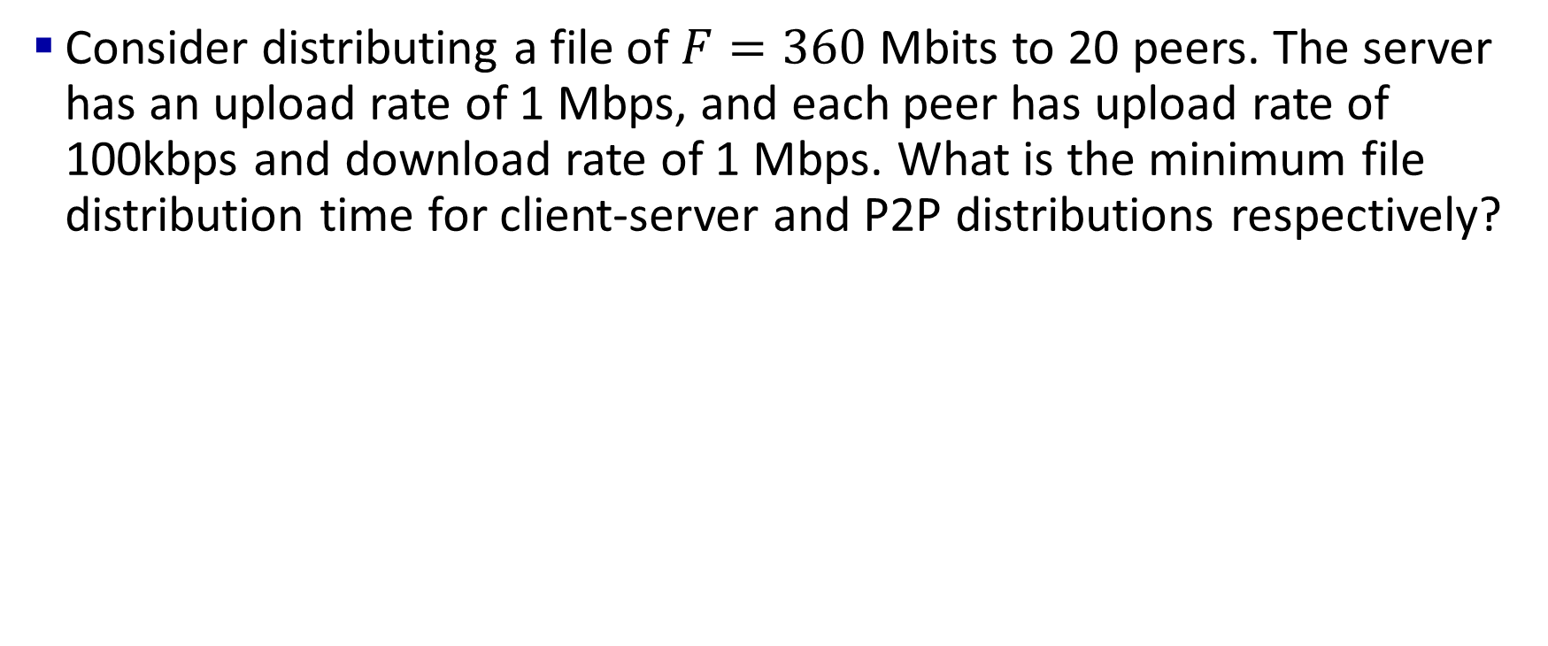
In-class exercise: file distribution time
Consider distributing a file of $F=360$ Mbits to 20 peers. The server has an upload rate of 1 Mbps, and each peer has upload rate of 100kbps and download rate of 1 Mbps. What is the minimum file distribution time for client-server and P2P distributions respectively?

Slide 46
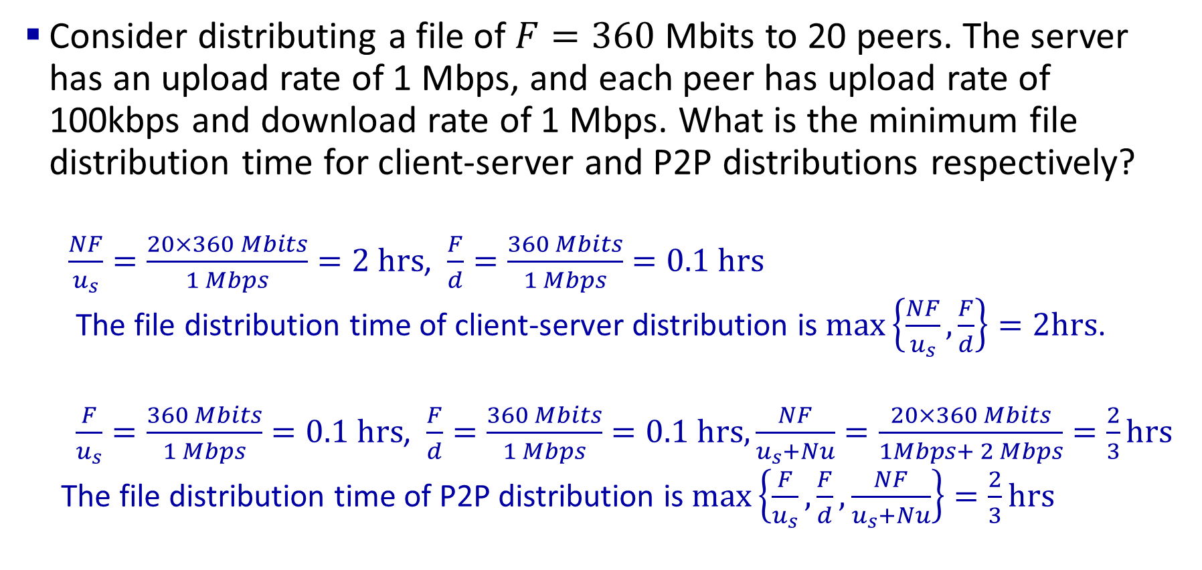
In-class exercise: file distribution time
Consider distributing a file of $F=360$ Mbits to 20 peers. The server has an upload rate of 1 Mbps, and each peer has upload rate of 100kbps and download rate of 1 Mbps. What is the minimum file distribution time for client-server and P2P distributions respectively?
$\frac{NF}{u_{s}}=\frac{20×360 Mbits}{1 Mbps}=2 hrs$, $\frac{F}{d}=\frac{360 Mbits}{1 Mbps}=0.1 hrs$
The file distribution time of client-server distribution is $max\left\{\frac{NF}{u_{s}},\frac{F}{d}\right\}=2hrs$.
$\frac{F}{u_{s}}=\frac{360 Mbits}{1 Mbps}=0.1 hrs$, $\frac{F}{d}=\frac{360 Mbits}{1 Mbps}=0.1 hrs,\frac{NF}{u_{s}+Nu}=\frac{20×360 Mbits}{1Mbps+ 2 Mbps}=\frac{2}{3}hrs$
The file distribution time of P2P distribution is $max\left\{\frac{F}{u_{s}},\frac{F}{d},\frac{NF}{u_{s}+Nu}\right\}=\frac{2}{3}hrs$

Slide 47
Client-server vs. P2P: example
client upload rate = u, F/u = 1 hour, u_{s} = 10u, d_{min} ≥ u_{s}

Slide 48


P2P file distribution: BitTorrent
file divided into 256Kb chunks
peers in torrent send/receive file chunks
tracker: tracks peers
participating in torrent
torrent: group of peers exchanging chunks of a file
Alice arrives …
… obtains list
of peers from tracker
… and begins exchanging
file chunks with peers in torrent

Slide 49


P2P file distribution: BitTorrent
peer joining torrent:
has no chunks, but will accumulate them over time from other peers
registers with tracker to get list of peers, connects to subset of peers (“neighbors”)
while downloading, peer uploads chunks to other peers
peer may change peers with whom it exchanges chunks
churn: peers may come and go
once peer has entire file, it may (selfishly) leave or (altruistically) remain in torrent

Slide 50
BitTorrent: requesting, sending file chunks
Requesting chunks:
at any given time, different peers have different subsets of file chunks
periodically, Alice asks each peer for list of chunks that they have
Alice requests missing chunks from peers, rarest first
Sending chunks: tit-for-tat
Alice sends chunks to those four peers currently sending her chunks at highest rate
other peers are choked by Alice (do not receive chunks from her)
re-evaluate top 4 every10 secs
every 30 secs: randomly select another peer, starts sending chunks
“optimistically unchoke” this peer
newly chosen peer may join top 4

Slide 51
BitTorrent: tit-for-tat
(1) Alice “optimistically unchokes” Bob
(2) Alice becomes one of Bob’s top-four providers; Bob reciprocates
(3) Bob becomes one of Alice’s top-four providers
higher upload rate: find better trading partners, get file faster !

Slide 52
Examples applications we will discuss
Web applications: client-server
Video streaming: client-server
P2P file distribution: peer-to-peer
E-Mail: client-server

Slide 53
Example: E-mail
user
agent
Three major components:
user agents
mail servers
simple mail transfer protocol: SMTP
mail
server
user
agent
SMTP
mail
server
user
agent
SMTP
SMTP
user
agent
mail
server
user
agent
user
agent
outgoing
message queue
user mailbox

Slide 54
E-mail: user agents
user
agent
a.k.a. “mail reader”
composing, editing, reading mail messages
e.g., Outlook, iPhone mail client
Outgoing and incoming messages stored on server
Messages can be read/copied on local devices through the user agents.
user
agent
user
agent
user
agent
user
agent
user
agent

Slide 55
E-mail: mail servers
user
agent
Store outgoing and incoming messages
mailbox contains incoming messages for user
message queue of outgoing (to be sent) mail messages
mail
server
user
agent
mail
server
user
agent
user
agent
mail
server
user
agent
user
agent
outgoing
message queue
user mailbox

Slide 56
E-mail: SMTP protocol
user
agent
SMTP protocol between mail servers to send email messages
client: sending mail server
“server”: receiving mail server
mail
server
user
agent
SMTP
mail
server
user
agent
SMTP
SMTP
user
agent
mail
server
user
agent
user
agent
outgoing
message queue
user mailbox

Slide 57
Mail message format
SMTP: protocol for exchanging e-mail messages, defined in RFC 5321 (like RFC 7231 defines HTTP)
RFC 2822 defines syntax for e-mail message itself (like HTML defines syntax for web documents)
header lines, e.g.,
To:
From:
Subject:
these lines, within the body of the email message area different from SMTP MAIL FROM:, RCPT TO: commands!
Body: the “message” , ASCII characters only
header
blank
line
body

Slide 58
Retrieving email: mail access protocols
user
agent
e-mail access
protocol
user
agent
SMTP
SMTP
(e.g., IMAP, HTTP)
sender’s e-mail
server
receiver’s e-mail
server
SMTP: delivery/storage of e-mail messages to receiver’s server
mail access protocol: retrieval from server
IMAP: Internet Mail Access Protocol [RFC 3501]: messages stored on server, IMAP provides functions like retrieval and deletion of folders of stored messages on server
HTTP: gmail, Hotmail, Yahoo!Mail, etc. provides web-based interface on top of STMP (to send), IMAP (or POP) to retrieve e-mail messages

Slide 59
Examples applications we have discussed!
Web applications: client-server
Video streaming: client-server
P2P file distribution: peer-to-peer
E-Mail: client-server

Slide 60
Examples applications we have discussed!
Web applications: client-server
Video streaming: client-server
P2P file distribution: peer-to-peer

Slide 61
Application Layer: Summary
our study of network application layer is now complete!
application architectures
client-server
P2P
application service requirements:
reliability, bandwidth, delay
Internet transport service model
connection-oriented, reliable: TCP
unreliable, datagrams: UDP
specific protocols:
HTTP
P2P: BitTorrent
SMTP, IMAP
video streaming, CDNs
socket programming:
TCP, UDP sockets

Slide 62
Application Layer: Summary
Most importantly: learned about protocols!
typical request/reply message exchange:
client requests info or service
server responds with data, status code
message formats:
headers: fields giving info about data
data: info(payload) being communicated
important themes:
centralized vs. decentralized
stateless vs. stateful
scalability
reliable vs. unreliable message transfer
“complexity at network edge”

